Slide 1

LEVEL 1/2 AWARD IN
Hospitality and Catering

Slide 2
WHAT WILL YOU STUDY?
The course is made up of two units:
Unit 1 – The Hospitality and Catering Industry, Theory work leading up to 1 online exam – worth 40% of final grade.
Unit 2 – Scenario based coursework project with practical cooking exam – 60% of final grade.
Practical exam – 4 hours to prepare, cook and serve 2 dishes with accompaniments.

Slide 3
WHAT SKILLS WILL YOU LEARN?
This course is designed to develop your practical cooking skills, as well as to give you an understanding of how the Hospitality and Catering industry works at different levels.From the restaurant brigade to housekeeping. Management positions to the kitchen brigade. We will look at the skills needed to become a chef, from Patisserie Chef, to Head Chef, Any of these can give you a full time job with excellent career opportunities, if you work hard enough!
You will also develop an understanding of different job roles in the industry and what skills and qualifications you need to be able to do these jobs.

Slide 4
WHAT WILL YOU STUDY?
To pass this course at level 1 or 2 you must complete all of the assessment criteria, as well as the written and practical exams. The assessment criteria are the modules of work set by the exam board.

Slide 5
SO WHERE COULD THIS COURSE LEAD YOU?
There are many job opportunities in the Hospitality and Catering Industry, rather than being ‘just a chef’ or ‘just a waiter’. Watch the film clips to see how you could fit into this industry.

Slide 6
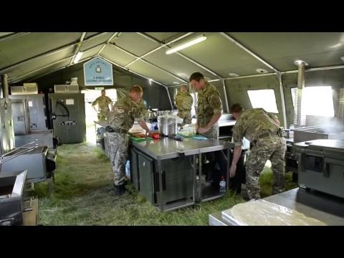
ARMED SERVICES

Slide 7
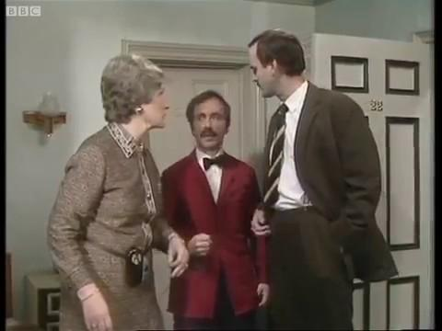
HOTEL MANAGEMENT

Slide 8
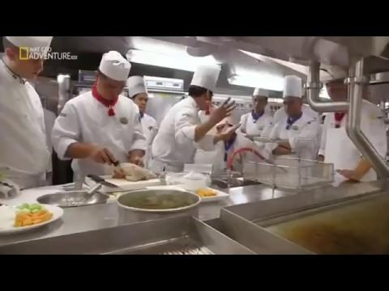
CRUISE LINERS

Slide 9
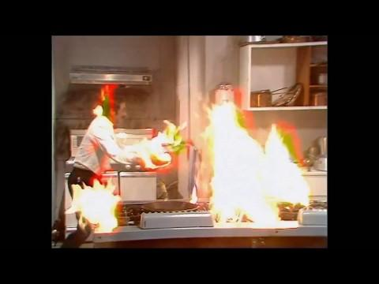
HEALTH AND SAFETY INSPECTOR

Slide 10
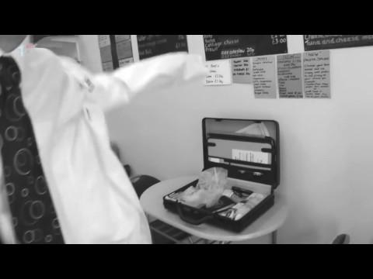
ENVIRONMENTAL HEALTH OFFICER

Slide 11
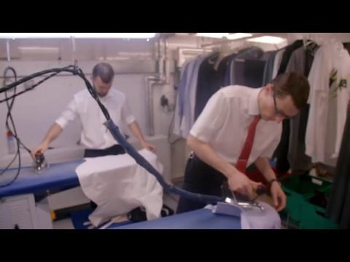
5* HOSPITALITY AND CATERING ESTABLISHMENTS

Slide 12
SO, IS THE HOSPITALITY AND CATERING INDUSTRY FOR YOU?
Some fun facts for you….
The Hospitality and Catering industry is expanding and always looking for Keen, enthusiastic young staff to make their businesses more successful.
Could YOU be one of them?

Slide 13
SO, IS THE HOSPITALITY AND CATERING INDUSTRY FOR YOU?
If so, consider choosing Hospitality and Catering as one of your options for Key Stage 4.
We look forward to seeing you in September.

Slide 14
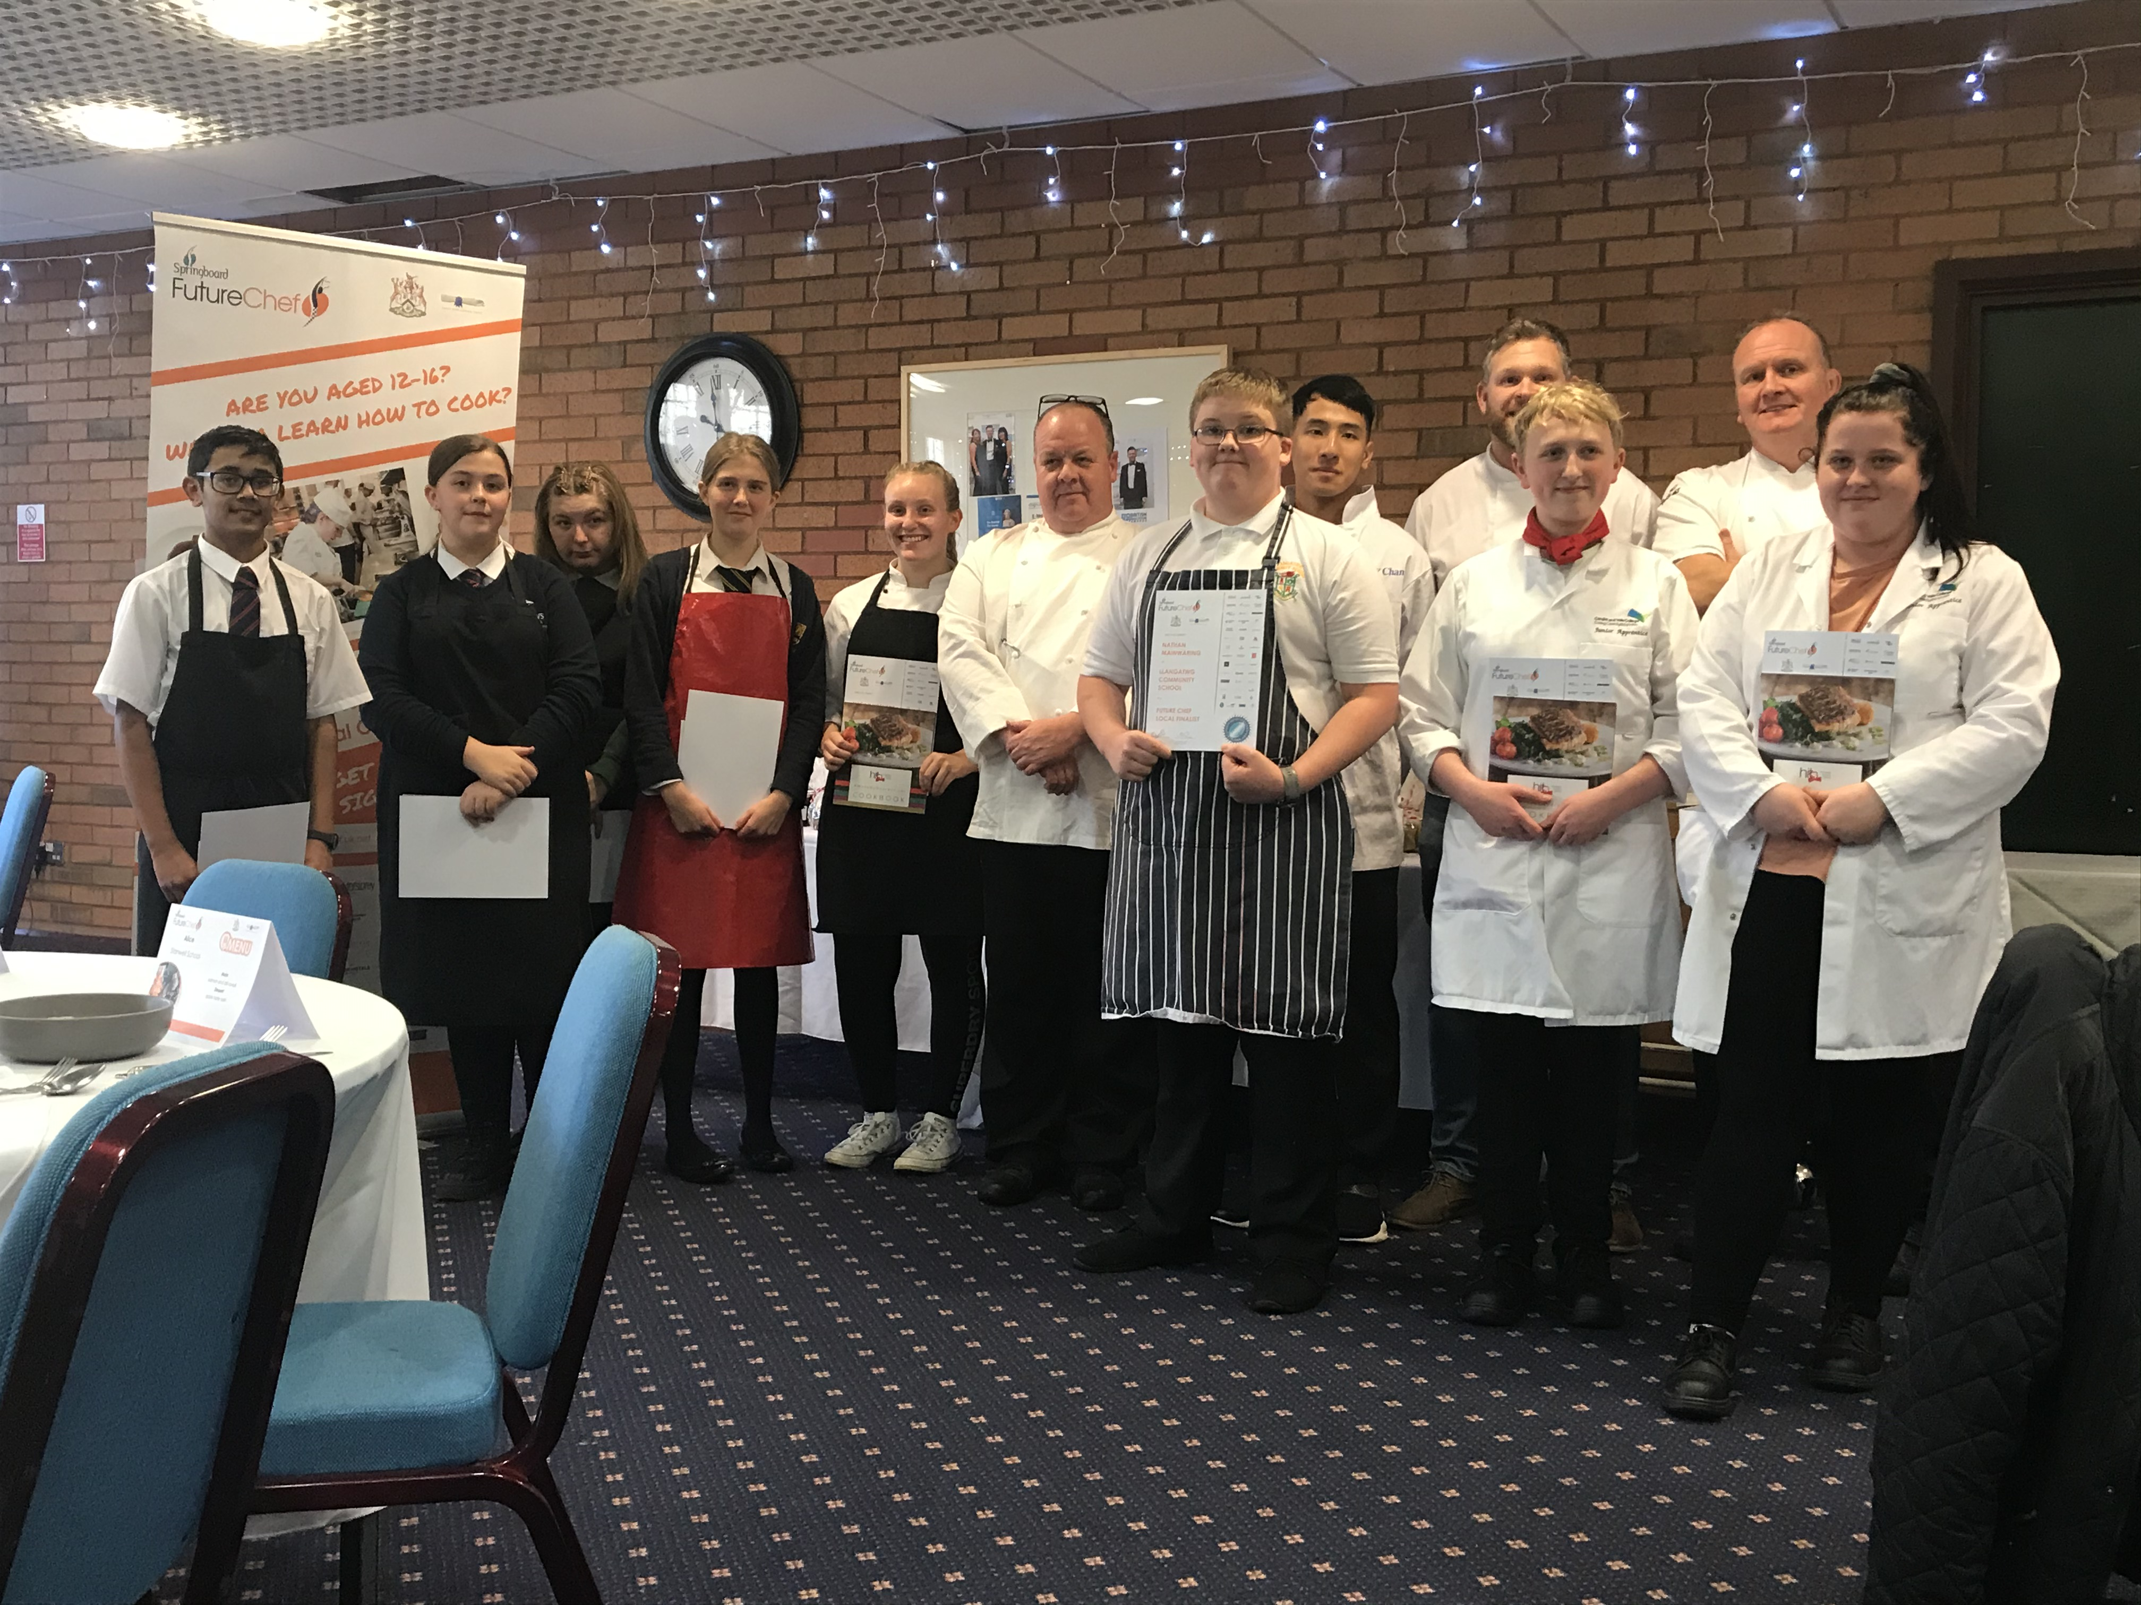
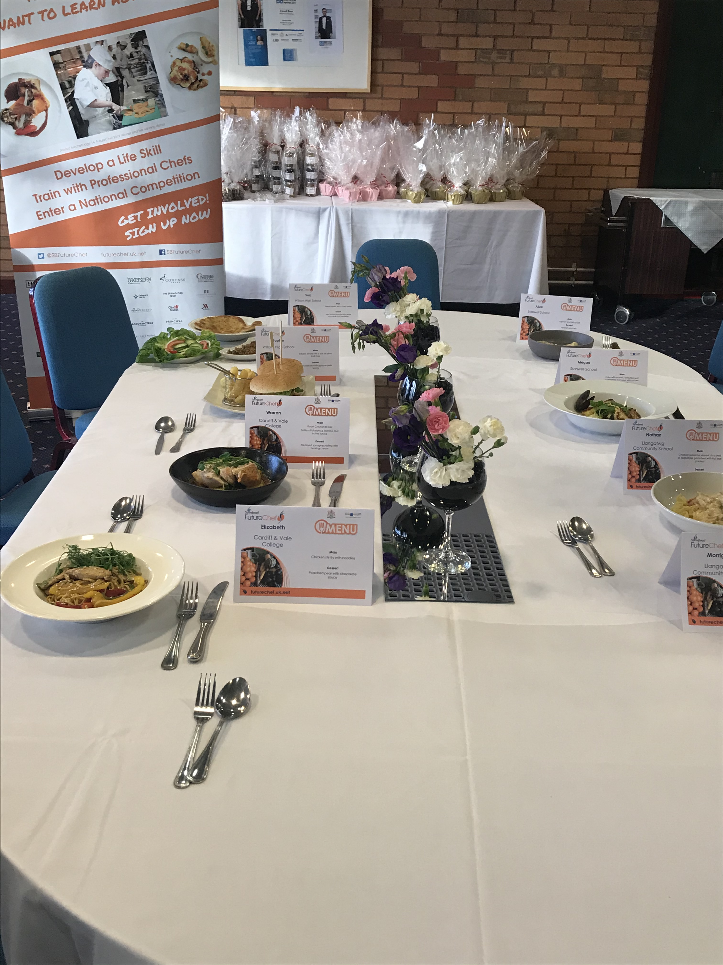
SUITABLE FOR ALL LEVELS OF LEARNER
Represent Willows High in the Future Chef
Competition !!

Slide 15
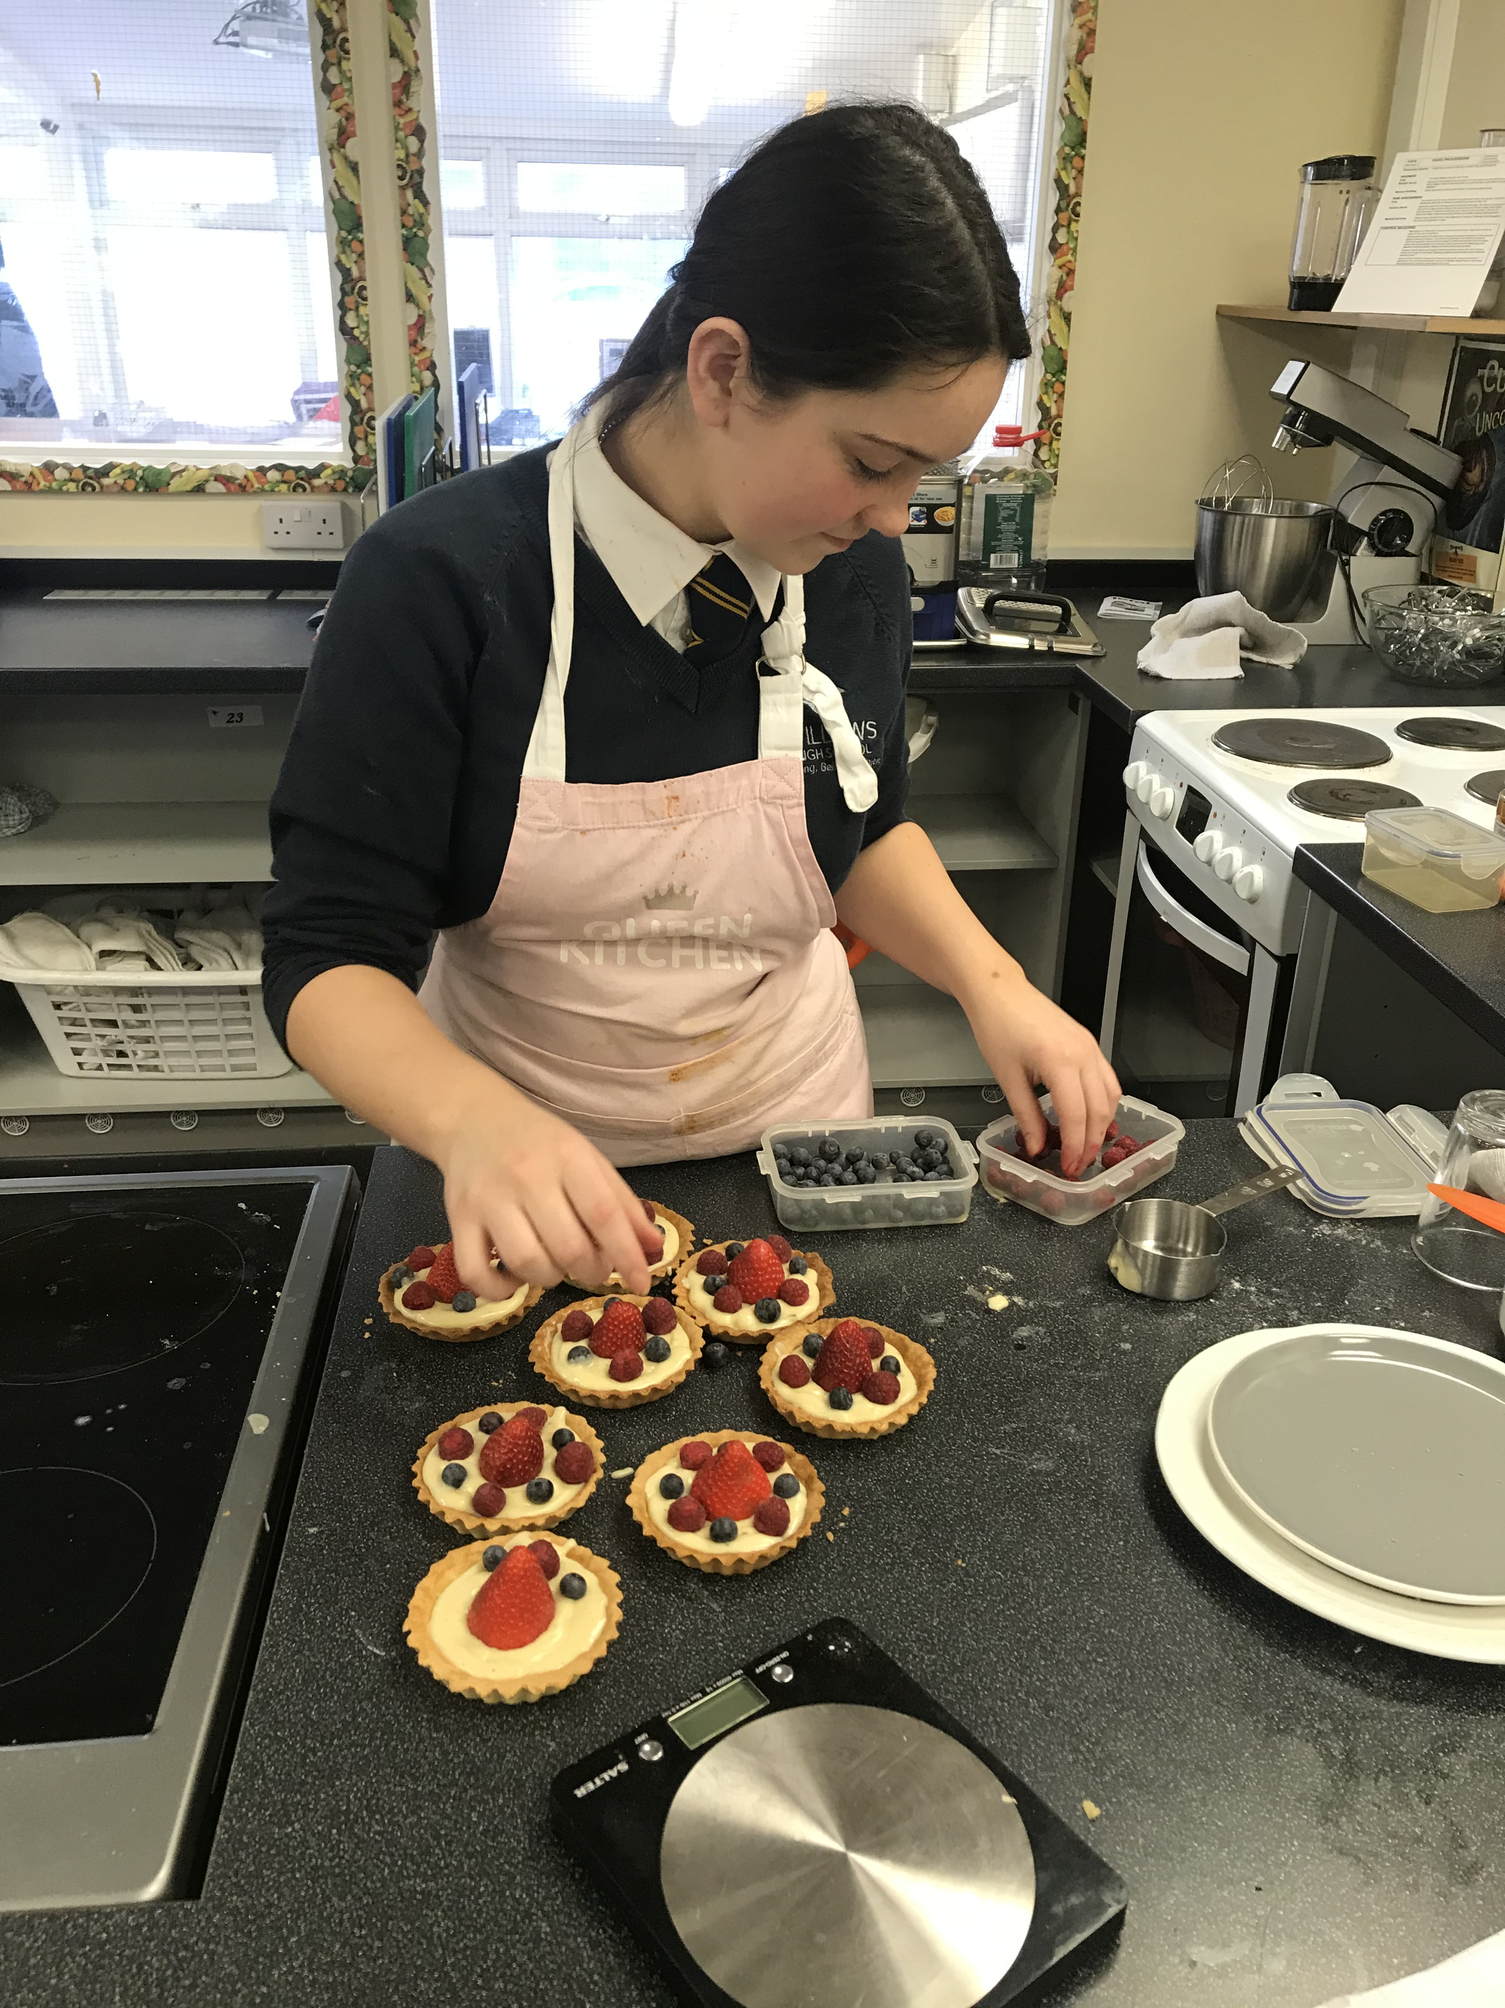
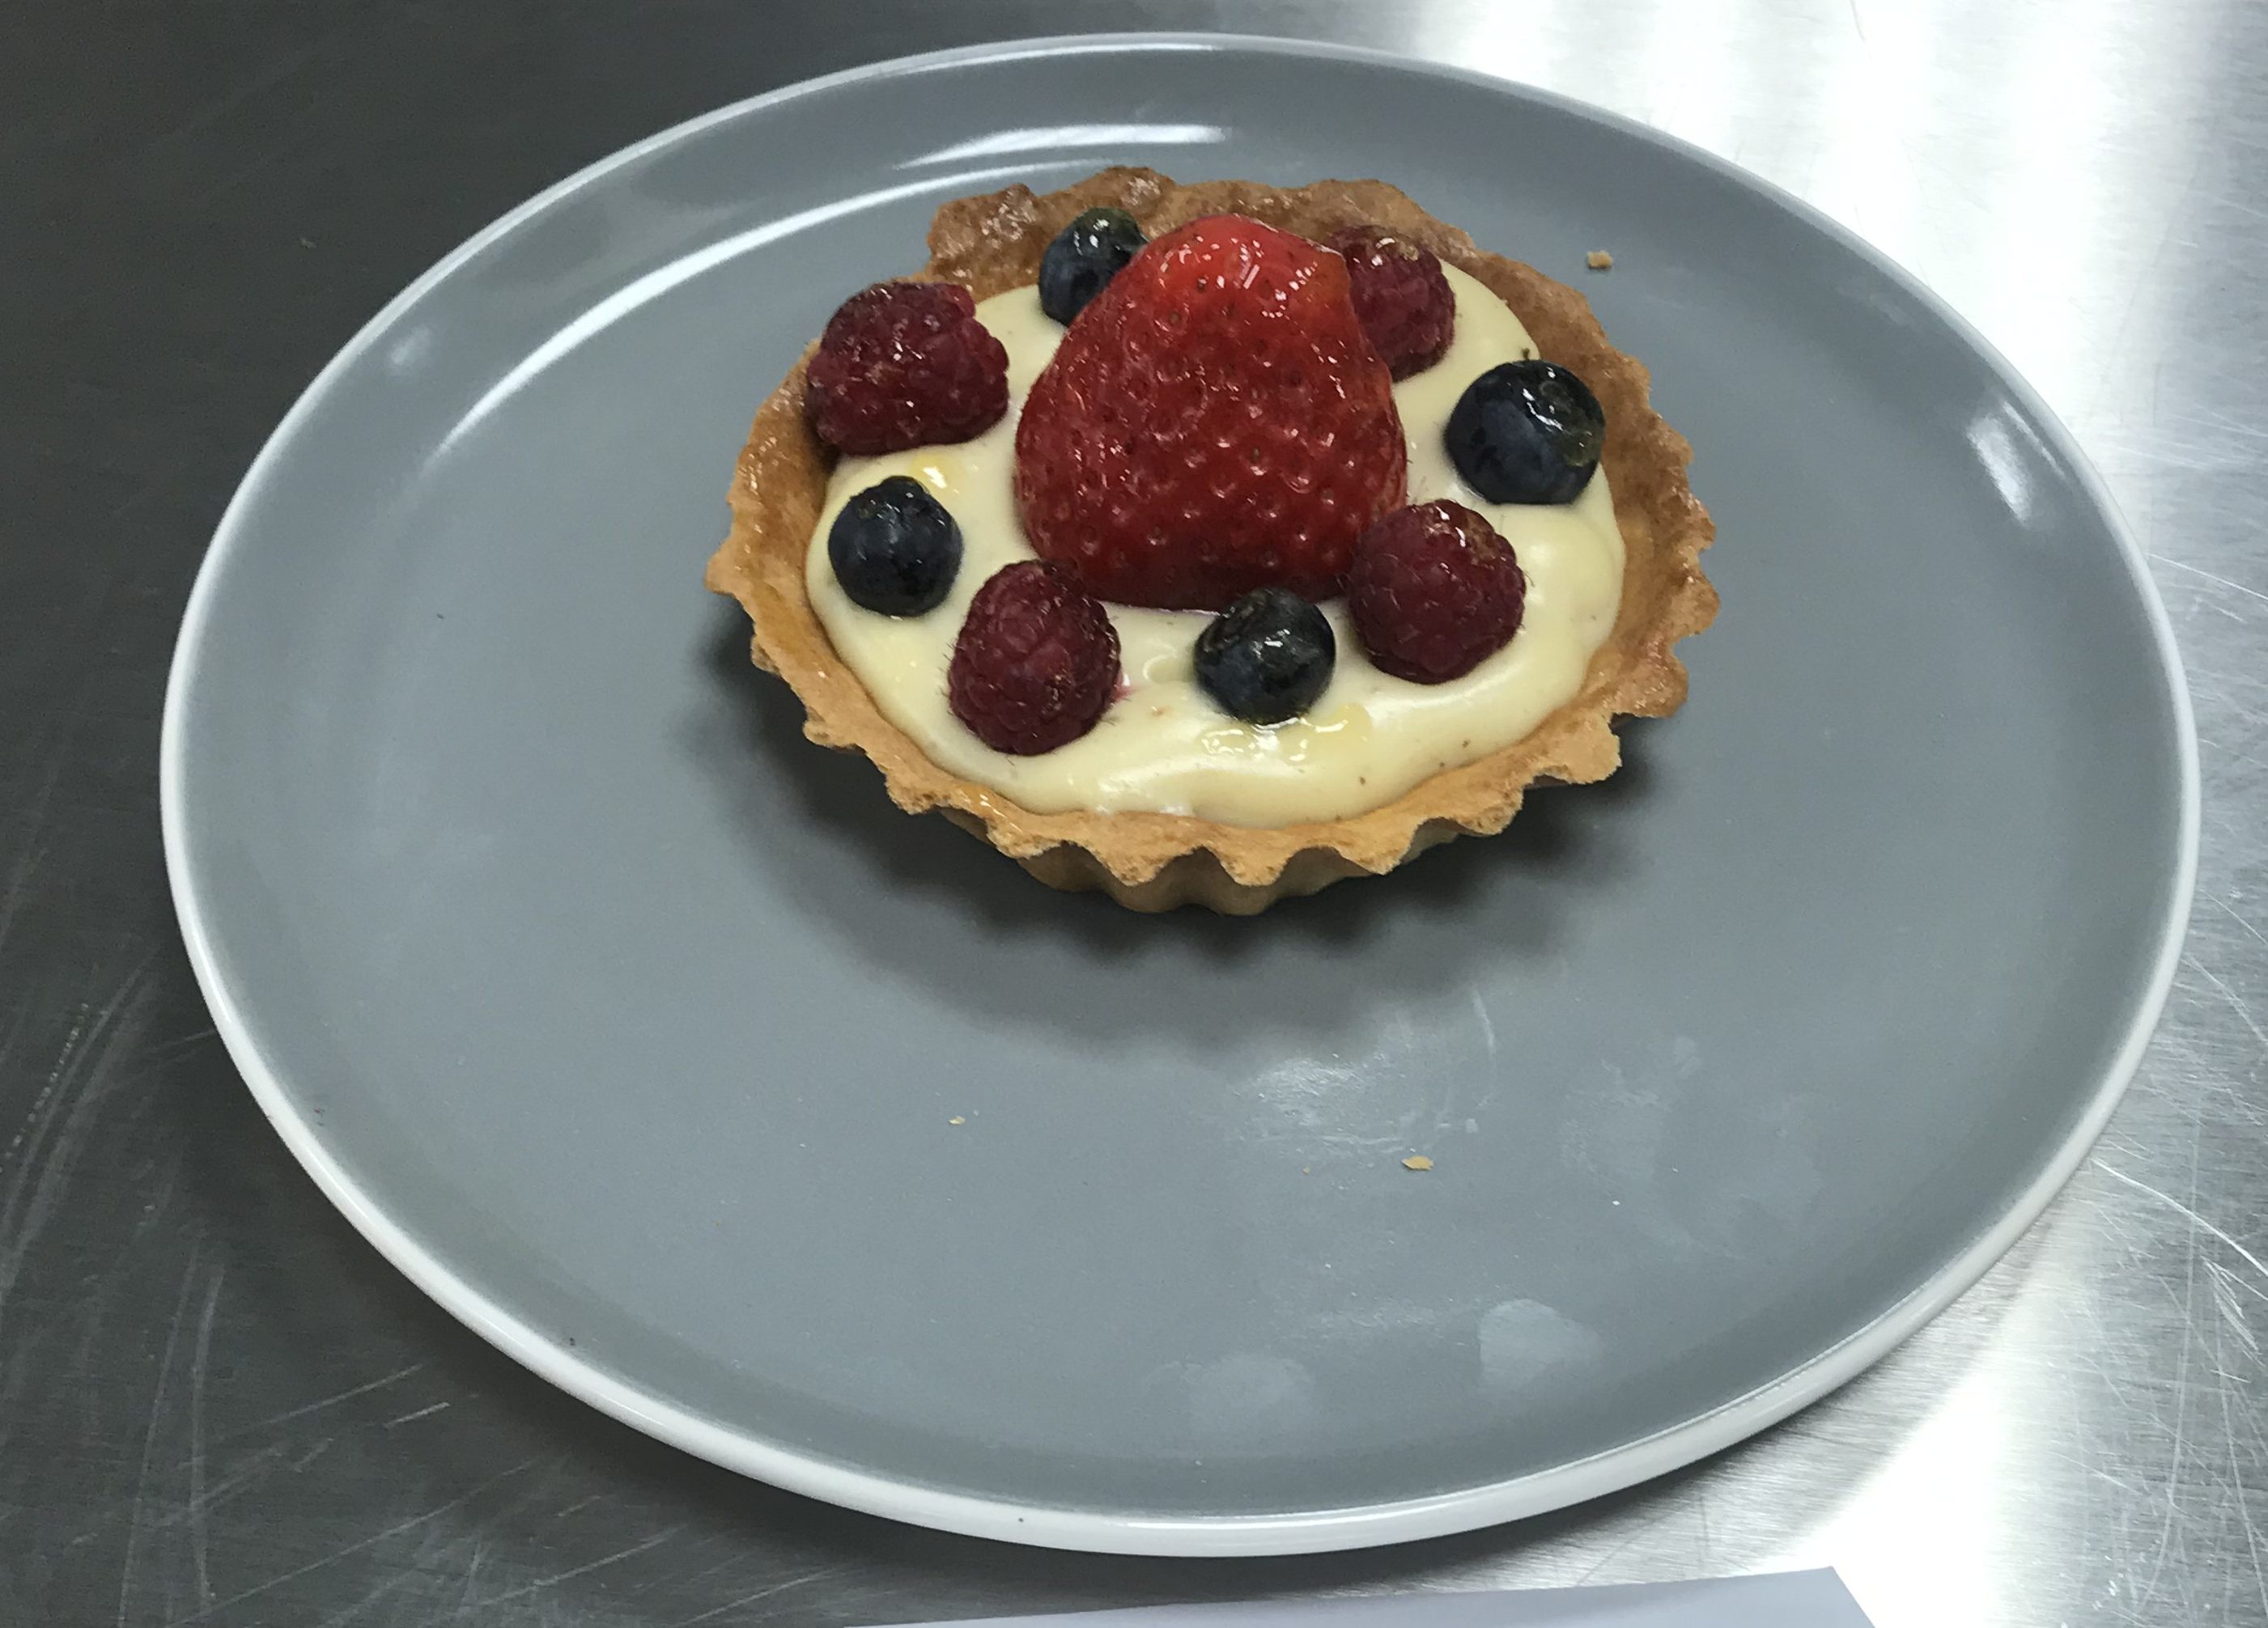
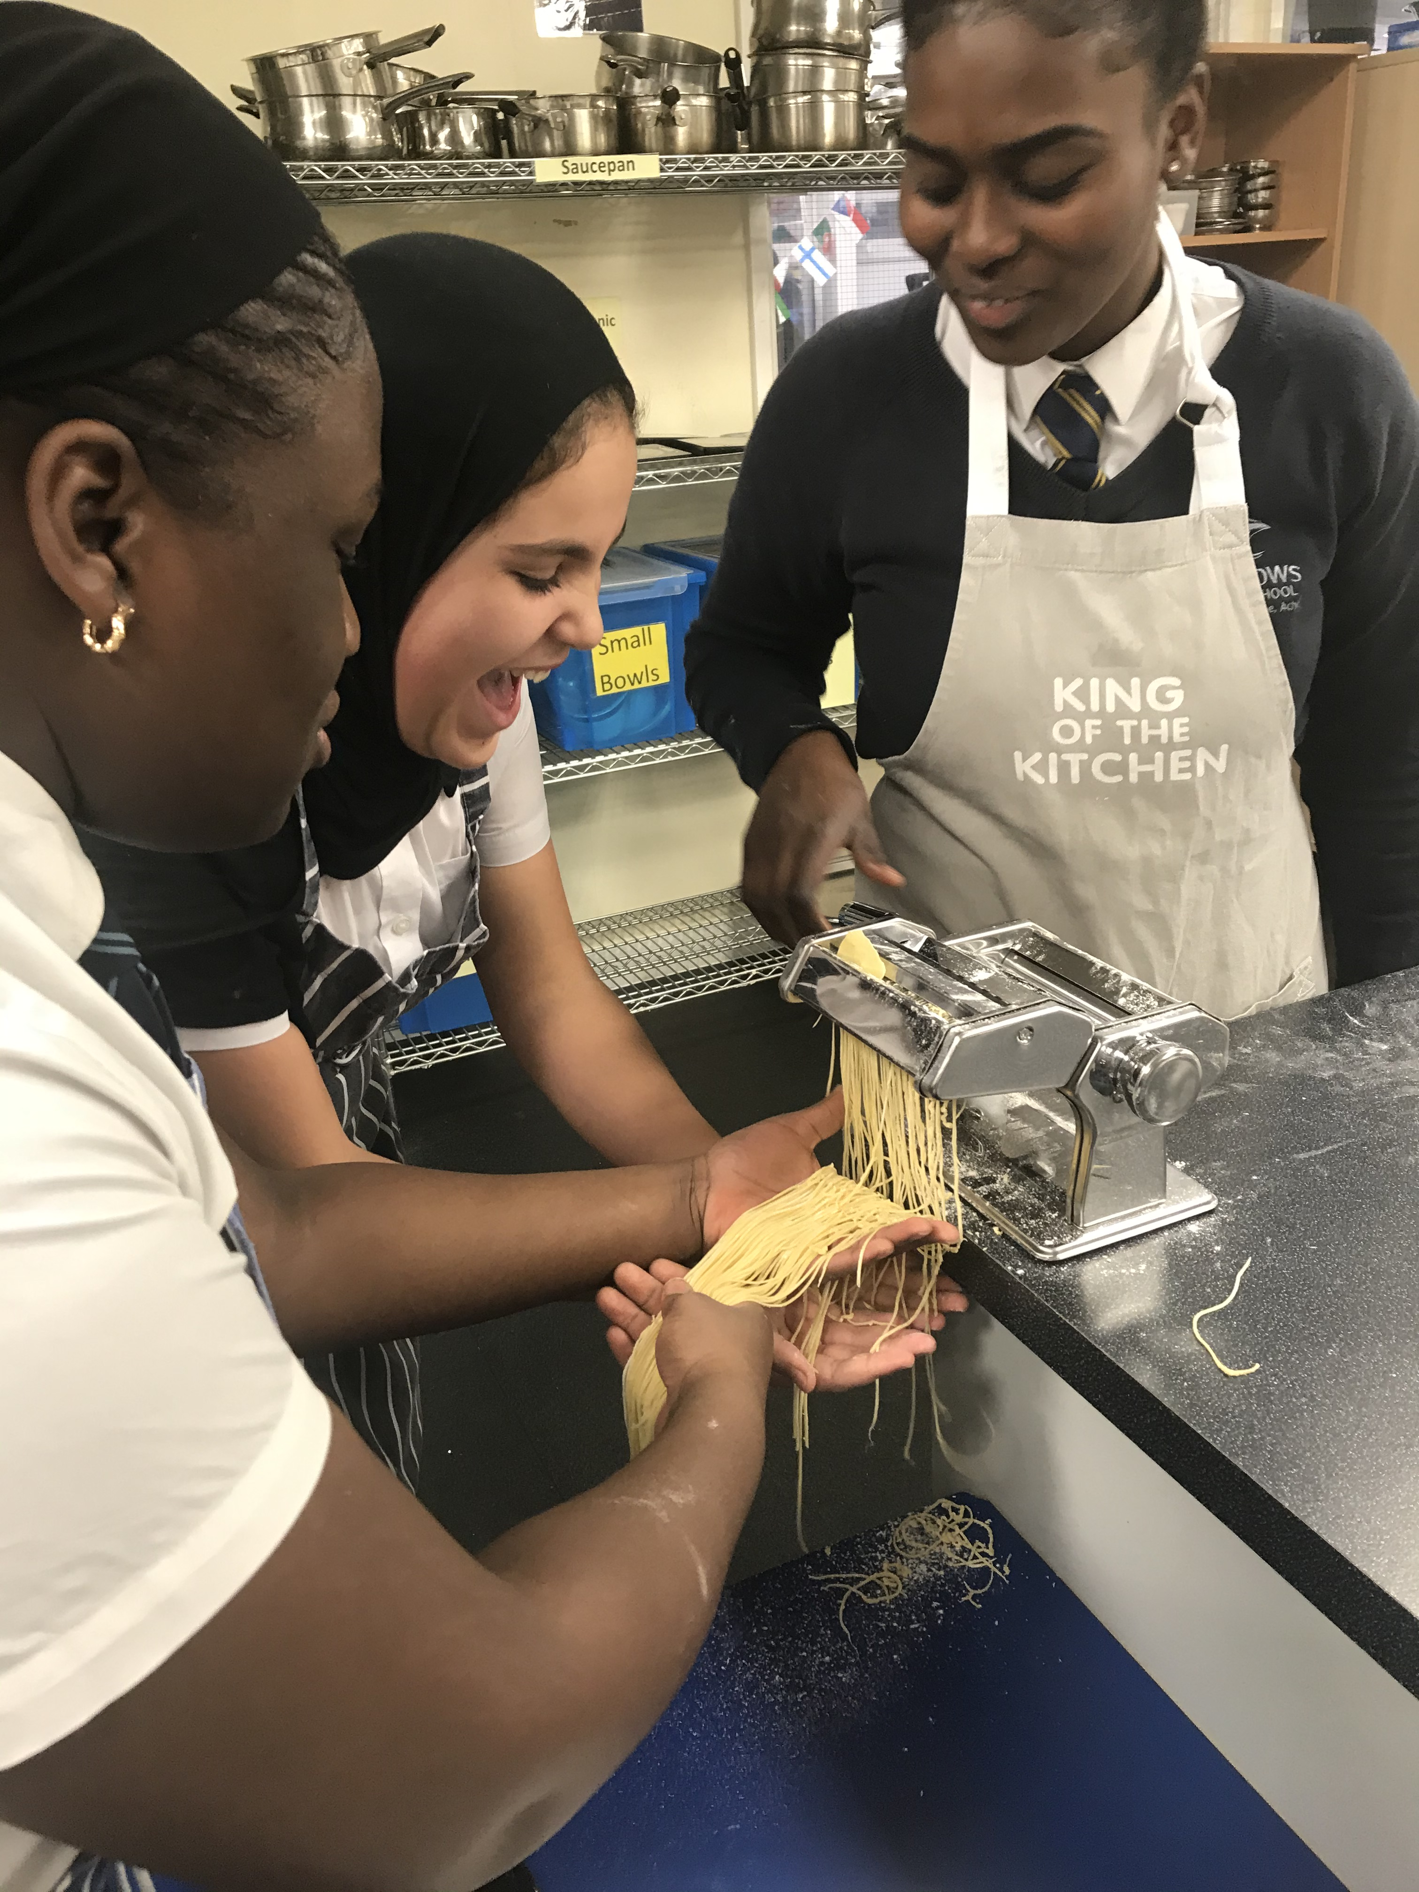
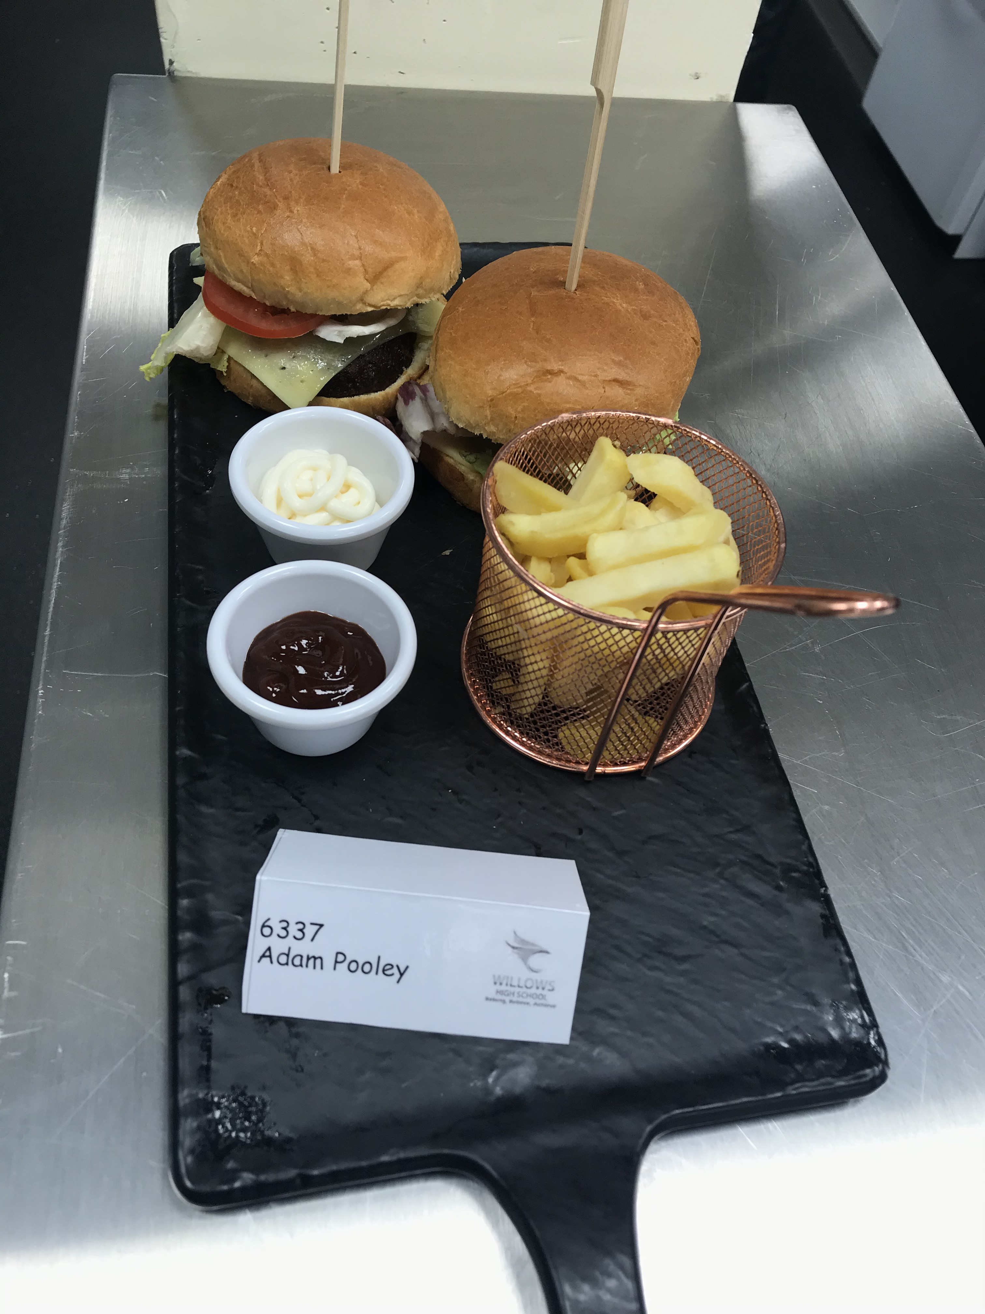
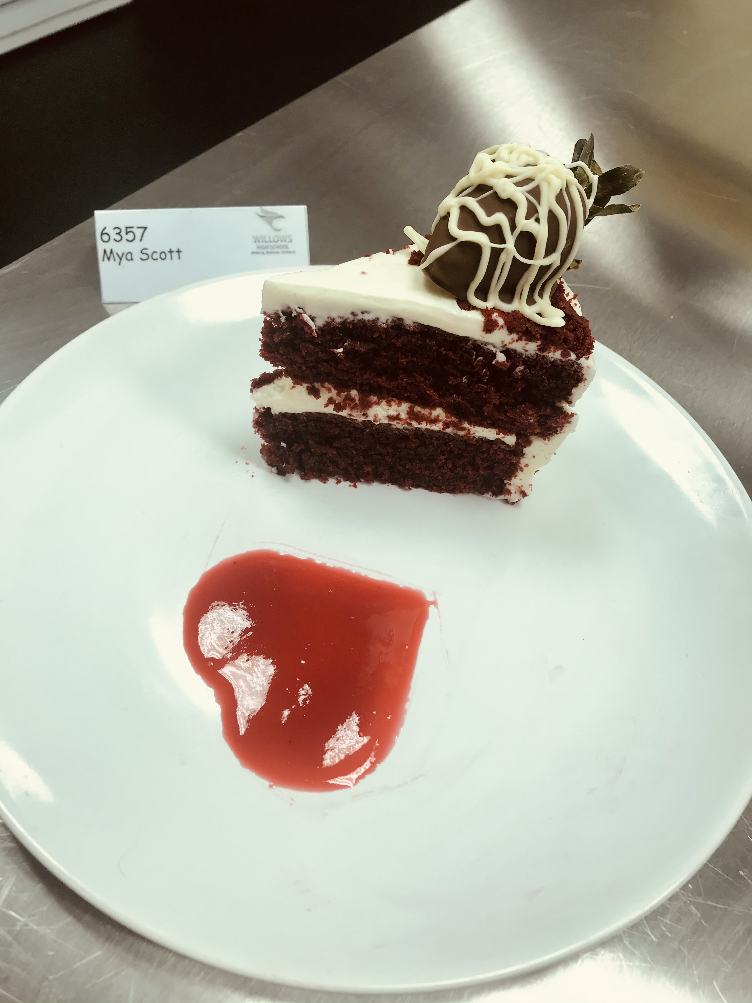
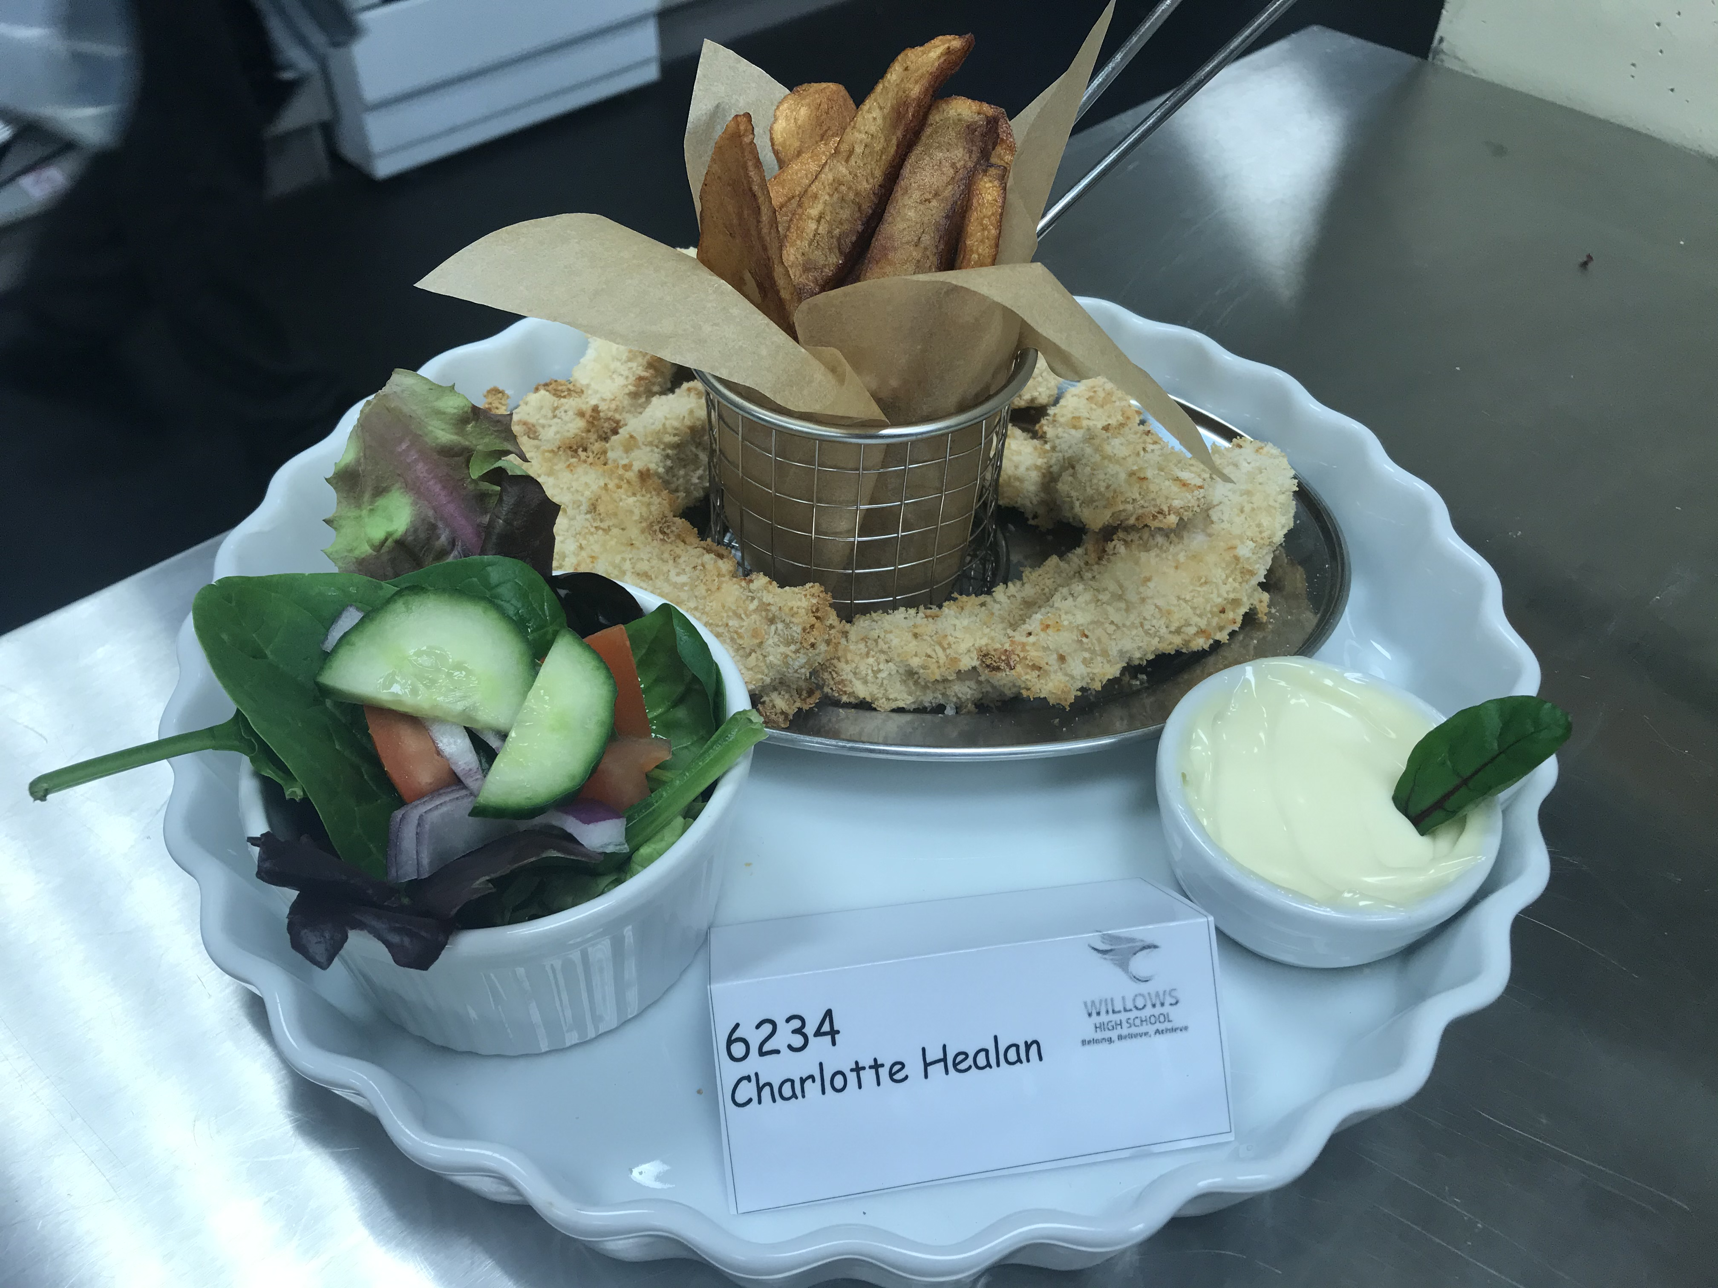
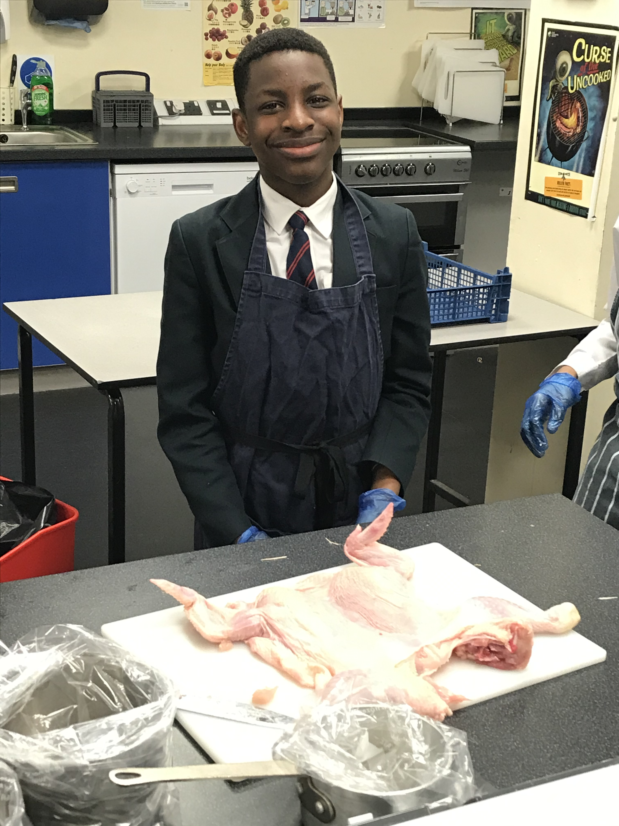
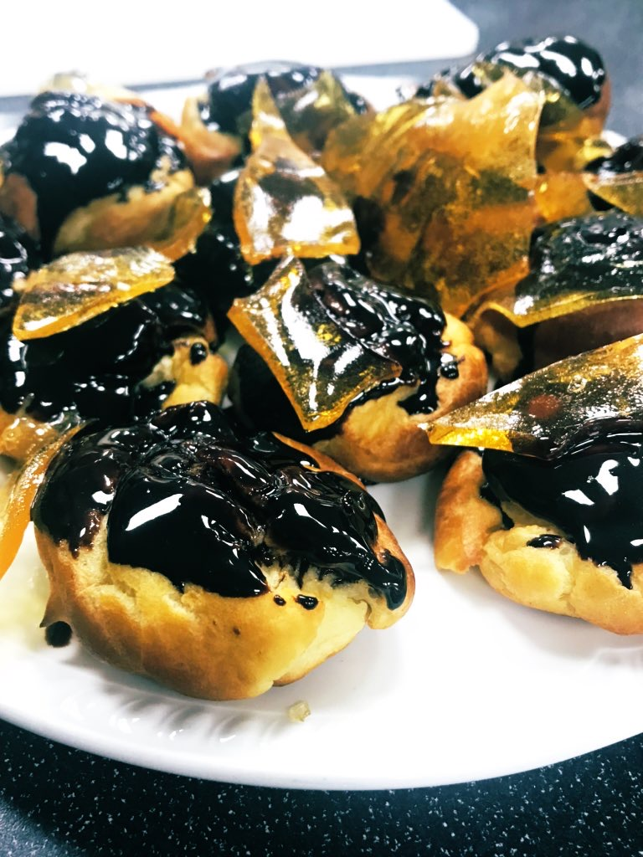
SUITABLE FOR ALL LEVELS OF LEARNER
Past Students

