Slide 1
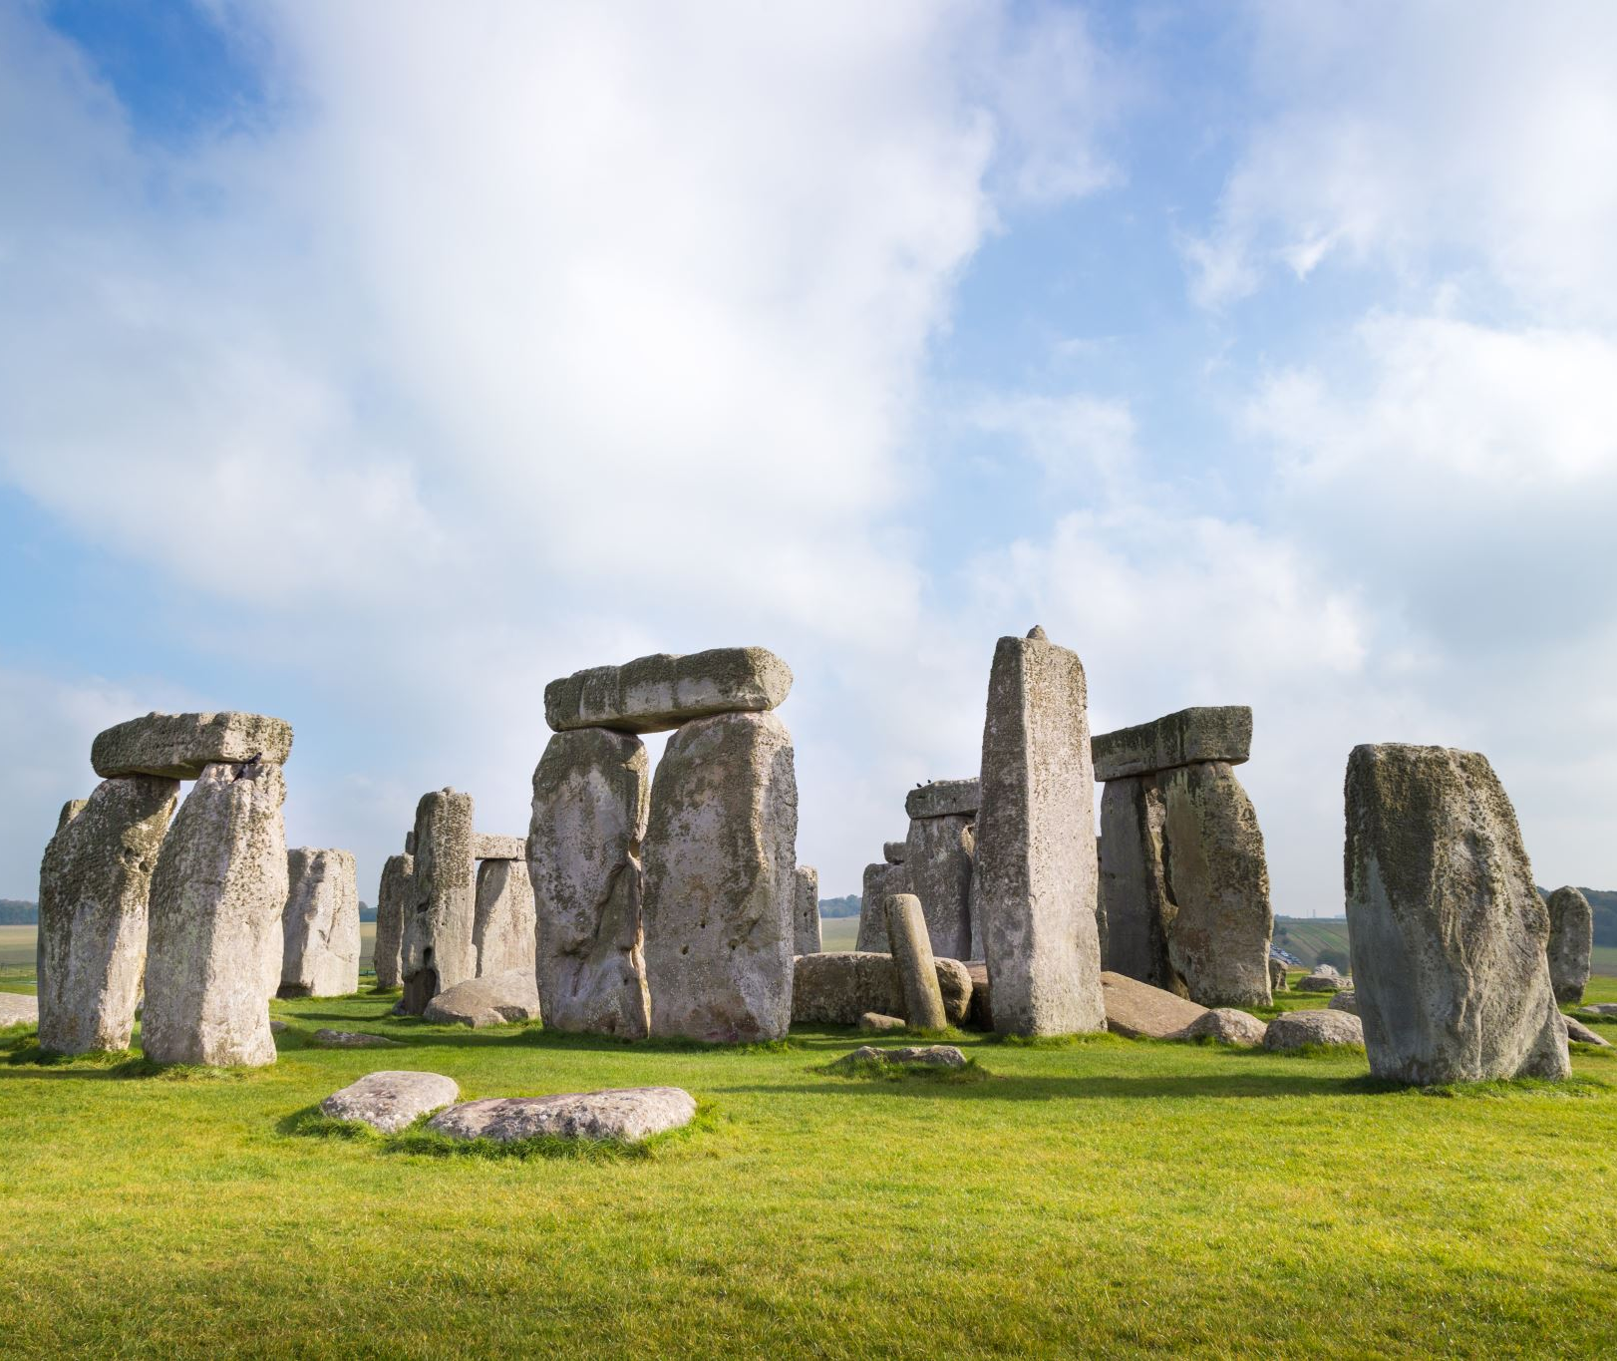

GCSE History
Why choose History as a gcse option?

Slide 2
Why choose History?
What does the subject offer you?
The History GCSE itself is an extremely interesting subject.
Many of you have shown an interest in History this year and the GCSE has a wide range of interesting and engaging topics.
History tells us why the world is the way it is.
Transferable skills that will help you in other subjects and outside of school.
  Critical Analysis and interpretation
  Extended writing and literacy.
  Independent learning.
  Communication skills.

Slide 3
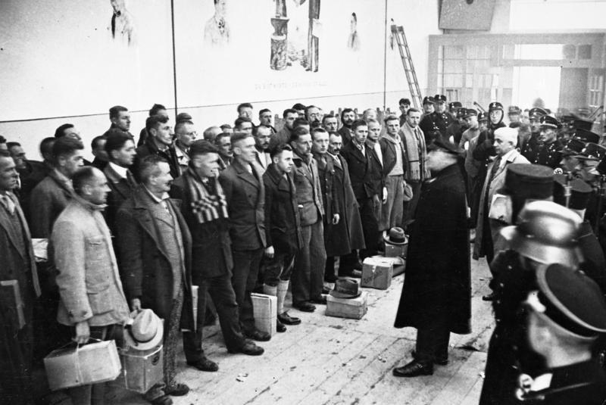
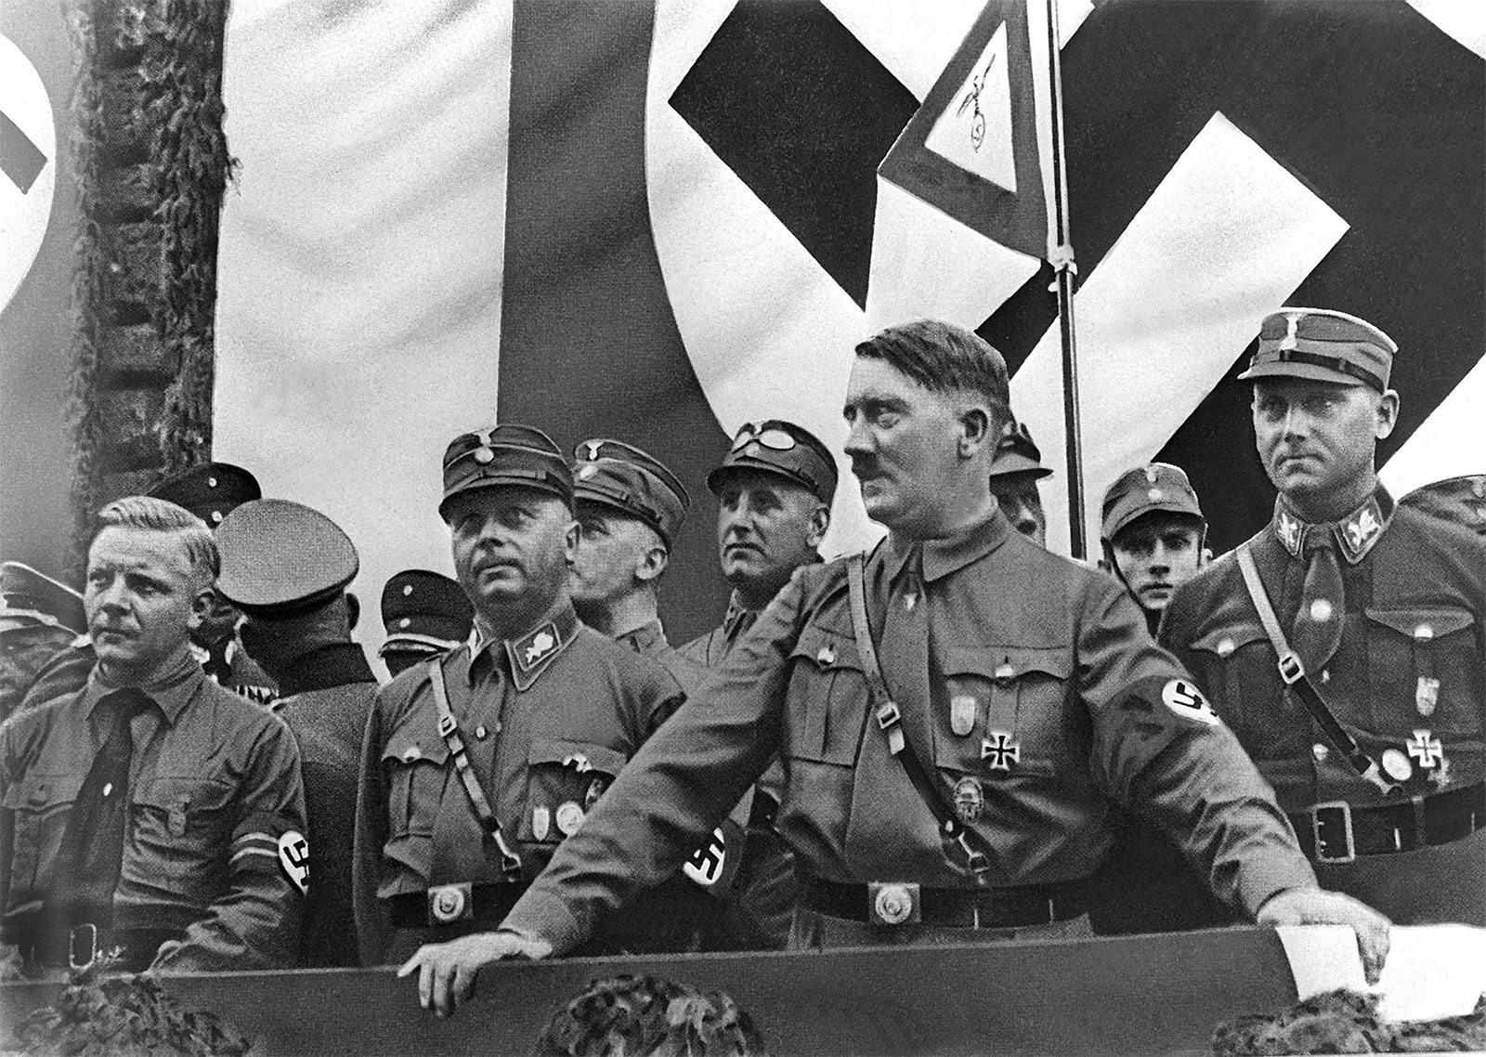
What is in the History gcse?
  The rise of Hitler and Nazi Germany.
    How Hitler gained power?
    How violent was Germany in the 20s?
    What was life like in Nazi Germany?
    How were different people (like Jews) treated in Germany?

Slide 4
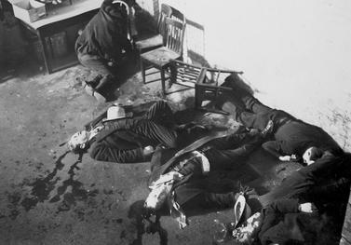
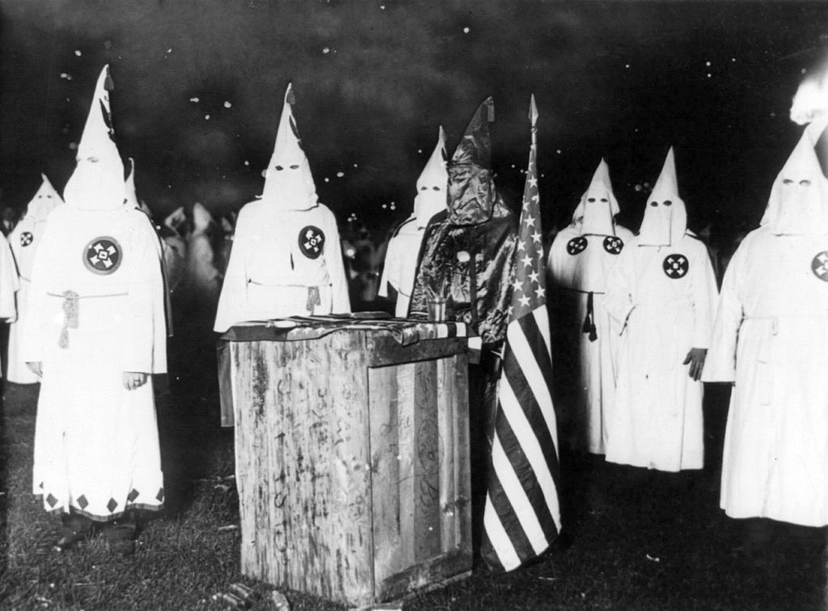
What is in the History gcse?
  The USA 1919-29
    Race and religion (The KKK, Black Americans and intolerance)
    Gangsters (The rise of the Mafia and crime.)
    How the role of women changed.
    Popular culture. (Hollywood and music.)

Slide 5
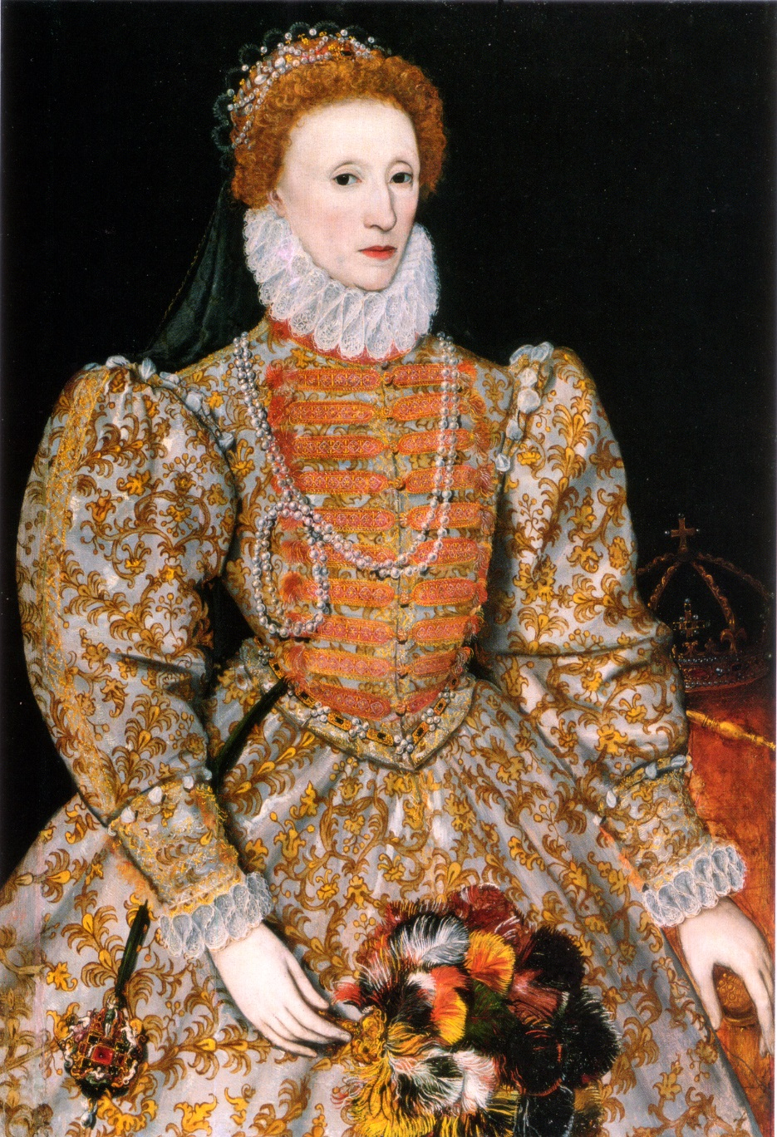
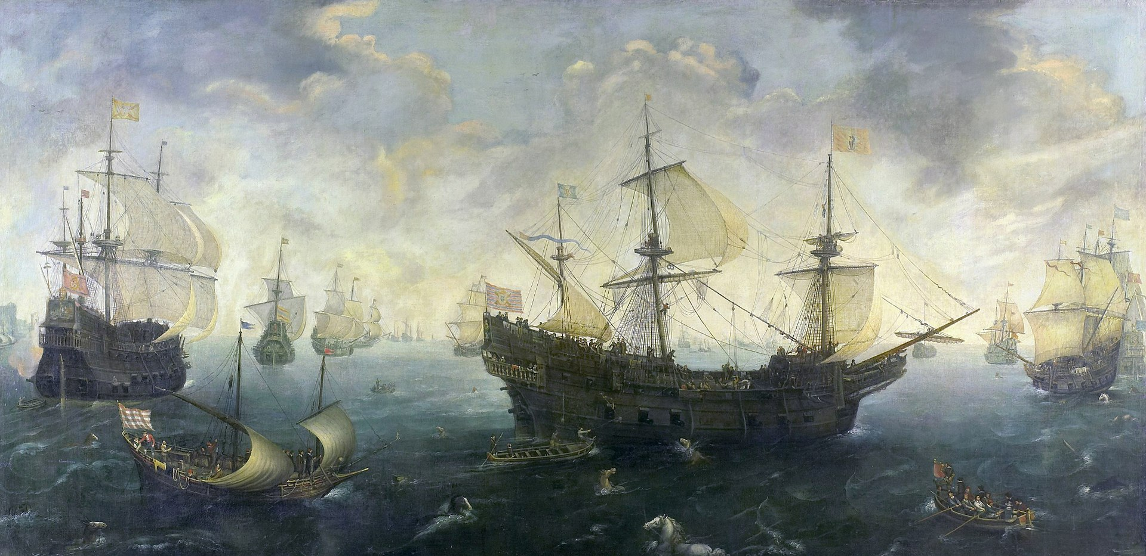
What is in the History gcse?
Elizabethan England
  The Tudor dynasty. (Henry VIII)
  Religious violence.
  The war with Spain, Pirates and The Spanish Armada
  The Queen herself.

Slide 6
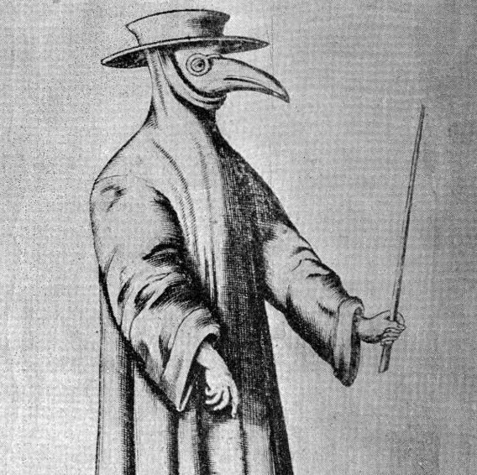
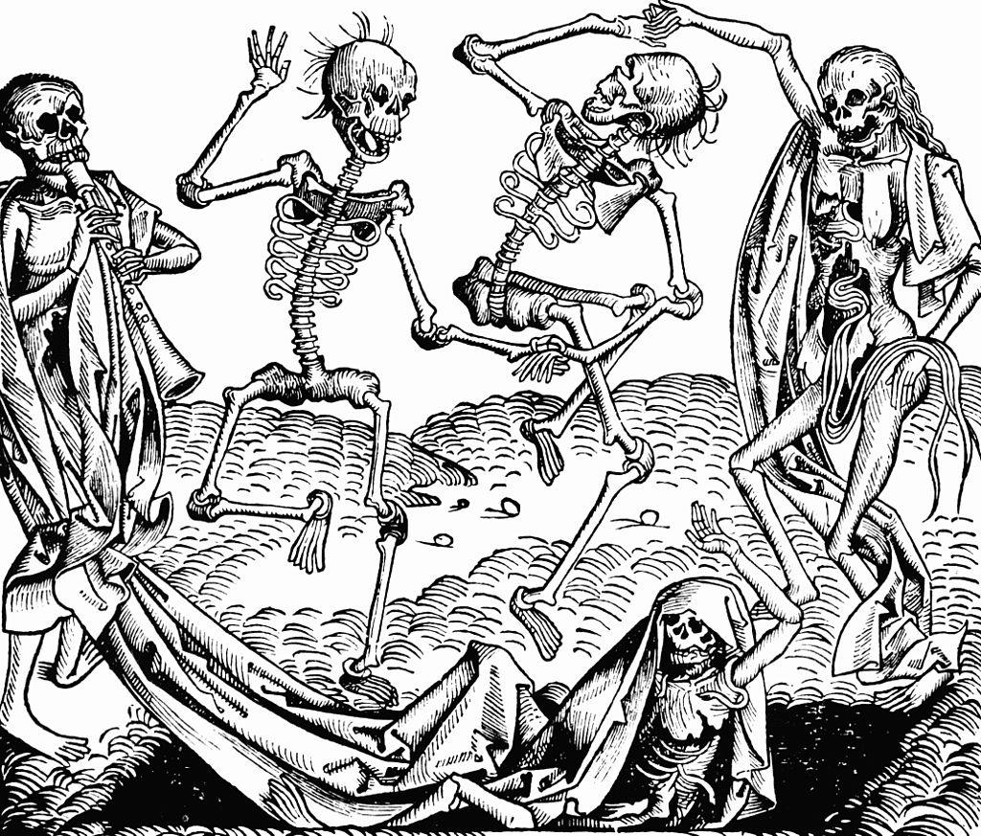
What is in the History gcse?
  Medicine Through Time
    Disease through 1000-2000
    The Black Death
    Medieval cures
    Witches and wise women
    Modern diseases and cures

Slide 7
Why choose GCSE History?
History is a challenging academic subject that colleges, universities and employers are always going to look for.
These groups know that a person with a History GCSE will have the following skills
  Critical Analysis and interpretation
  Extended writing and literacy.
  Independent learning.
  Communication skills.
  Wider knowledge of the world.
How will it help in your future?

Slide 8
What careers might History help with?
Teaching and research
Politics
Journalism
Working in the Media
Working for local or national government
Entering the armed forces as an officer
Police and community work

Slide 9
Why choose history?
It is interesting.
It will challenge you.
Gives you a great set of skills for what ever you choose to do.
It’s fun.

